Slide 1



Slide 2
Bachelor of Technology
Department of Computer Science and engineering
FULLSTACK PROJECT 2
Submitted To
Submitted by
Mr. Pankaj Kapoor
Naman Gupta (181500410)
Kush Mittal (181500342)
Tarun (181500756)
GLA University, Mathura
NH2 ,Mathura-Delhi road Mathura, Uttar Pradesh 281406 ,INDIA

Slide 3

Presentation on
CHAT APPLICATION

Slide 4
Introduction
Chat Application
About our system

Slide 5
What is chat application
Online chat may refer to any kind of communication over the Internet that offers a real-time transmission of text messages from sender to receiver.
Online chat in a less stringent definition may be primarily any direct text-based, one-on-one chat or one-to-many group chat.

Slide 6
Our System
◆ Our System is a Real Time Chat Application website from where people can chat online.
◆ Admin mange the user database .

Slide 7
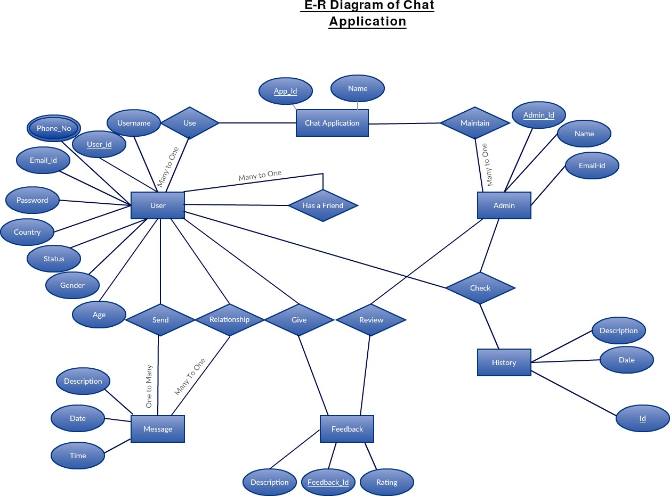
THE PROCESS OF chat application

Slide 8
Features:
User Login. Messaging is not only about sending text messages and pictures now.
Message Broadcasting.
Encryption.
Geolocation.
Push Notifications.

Slide 9
TOOLS :- 1.REACTjs 2.Chatengine.io 3.Nodejs 4.Vscode 5.github 6.internet 7.chrome browser (or any other web application)
Technology used

Slide 10
Hardware Requirement
System Requirement:-
Minimum Marshmallow version 7.0 ( for android )
Pentium IV or higher, (PIV- 300GHz recommended)
Hard-Disk 250GB or more
RAM 4GB or more
Processor i3 (7th Gen)
1024 x 768 Display
Internet

Slide 11
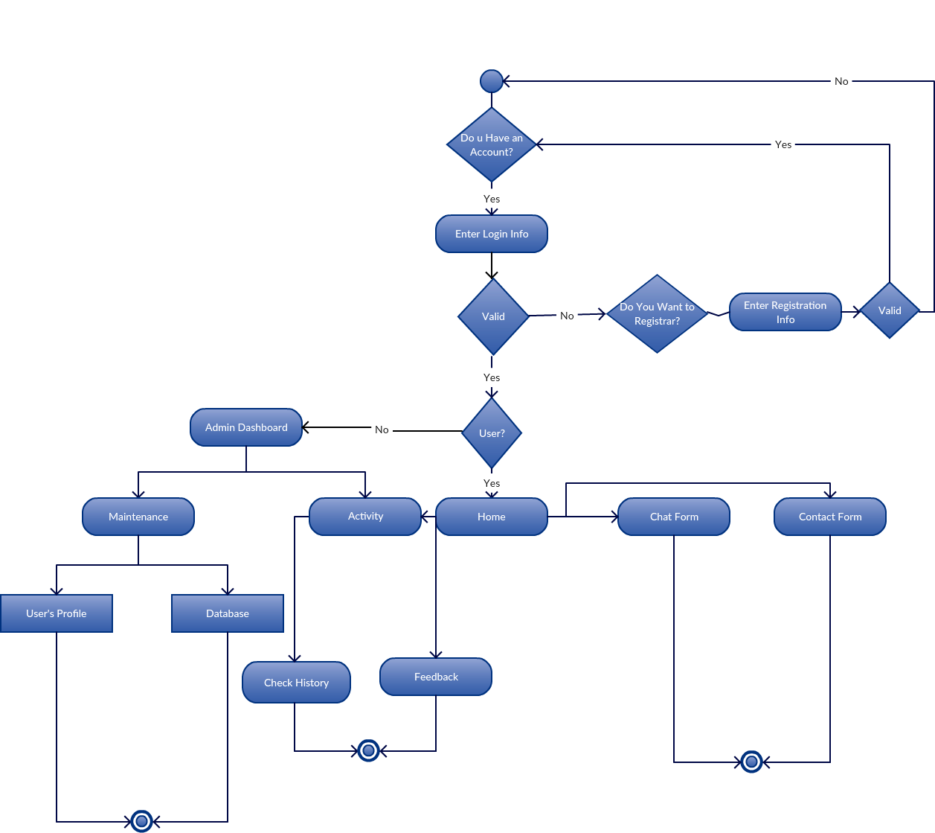
Activity diagram

Slide 12
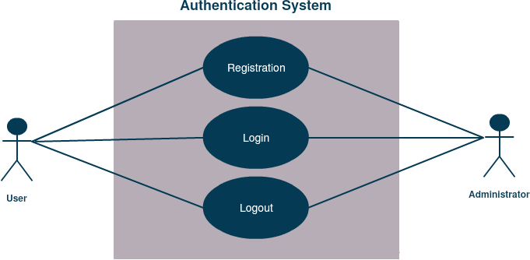
Use case diagram Authntication system
End

Slide 13
ADVANTAGES OF chat application
Real-time text preview.
Instant customer feedback..
Prevents agent fatigue.
No waiting queues. .
File Storage and Sharing

Slide 14
DISADVANTAGES OF chat application.
It's difficult to completely protect your privacy.
It can quickly drain the battery of your device.
It takes up a lot of space.

Slide 15
SCREENSHOT OF PROJECT
(GUI)

Slide 16
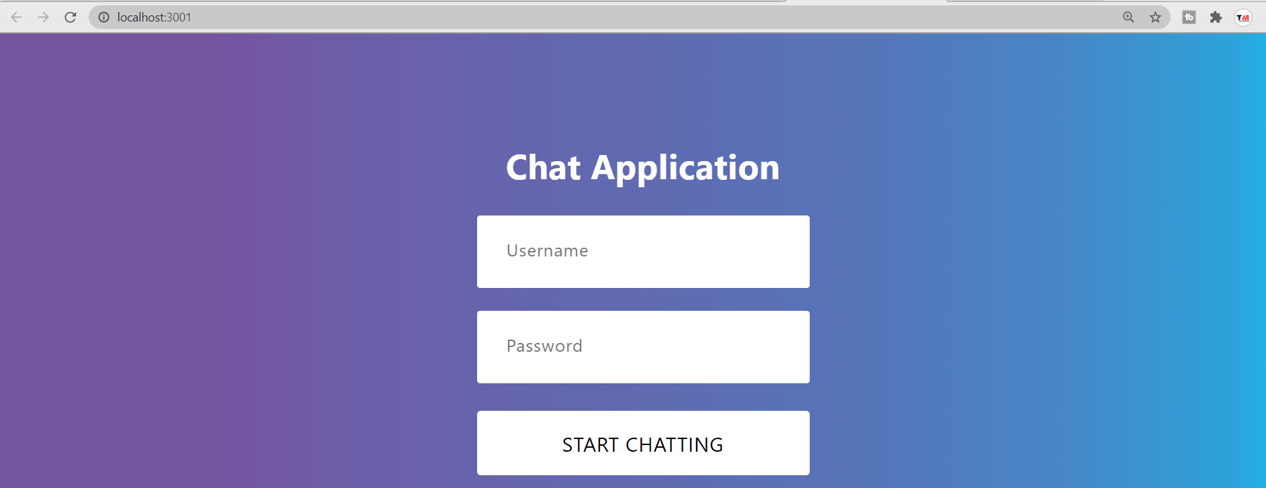

Slide 17
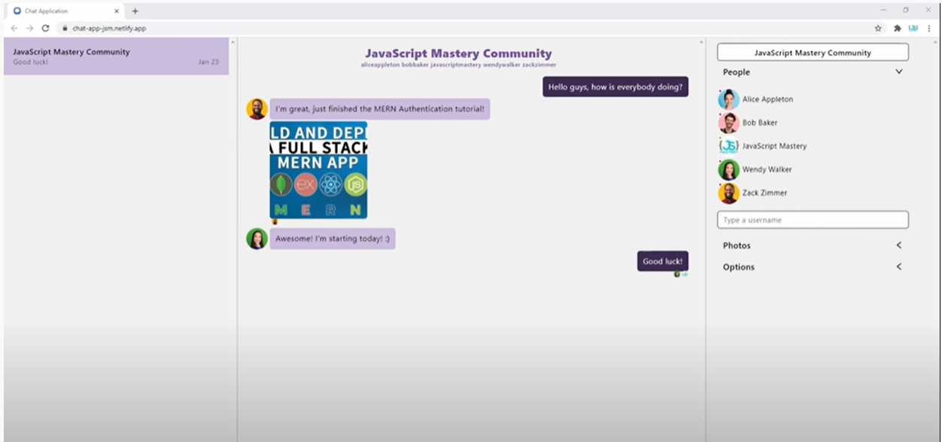

Slide 18
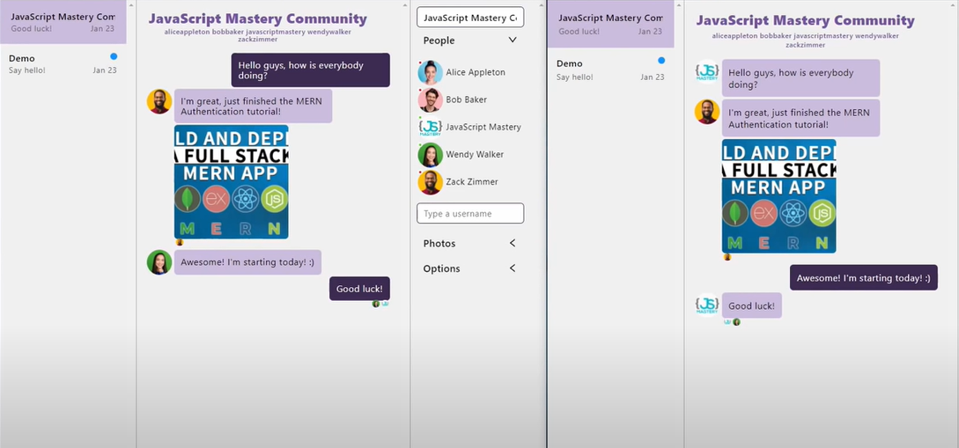

Slide 19
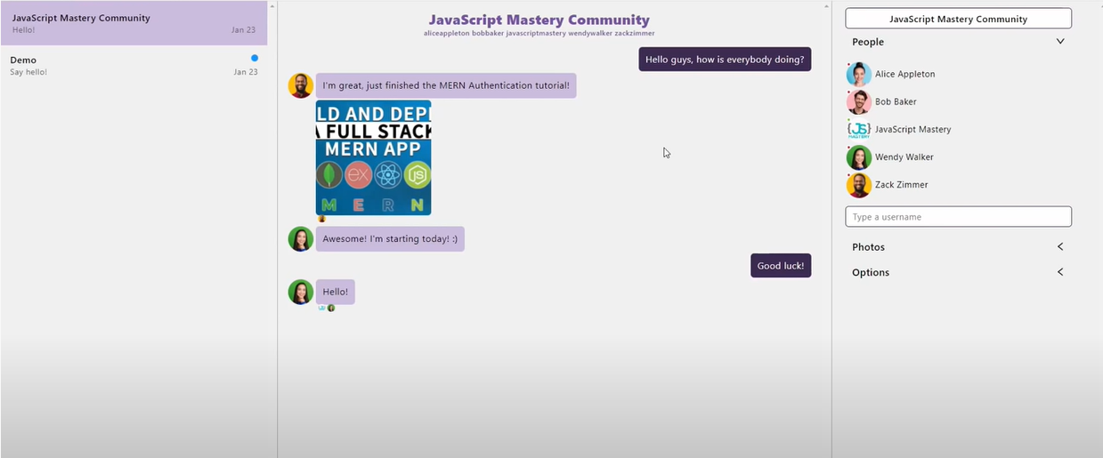

Slide 20
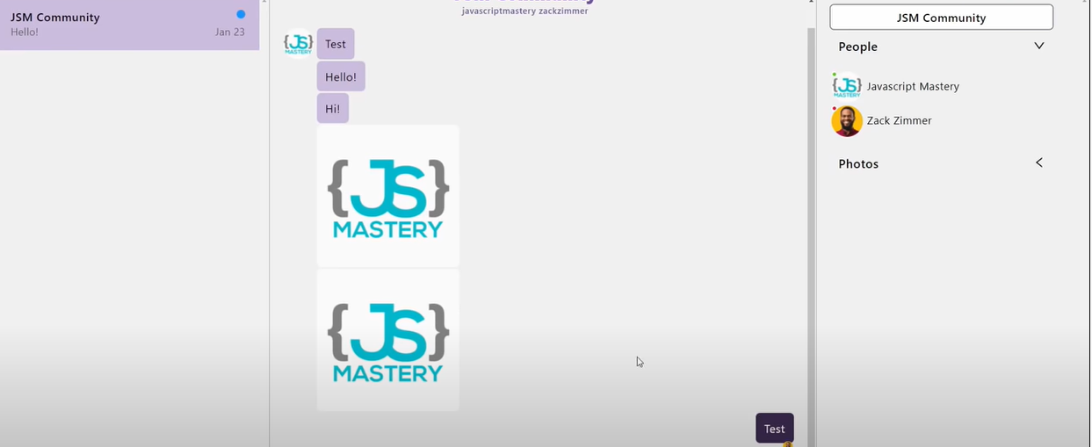

Slide 21
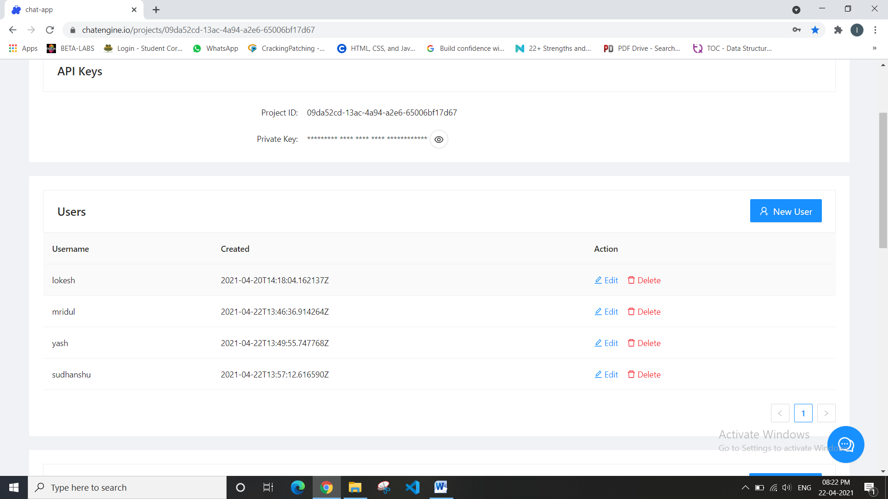

Slide 22
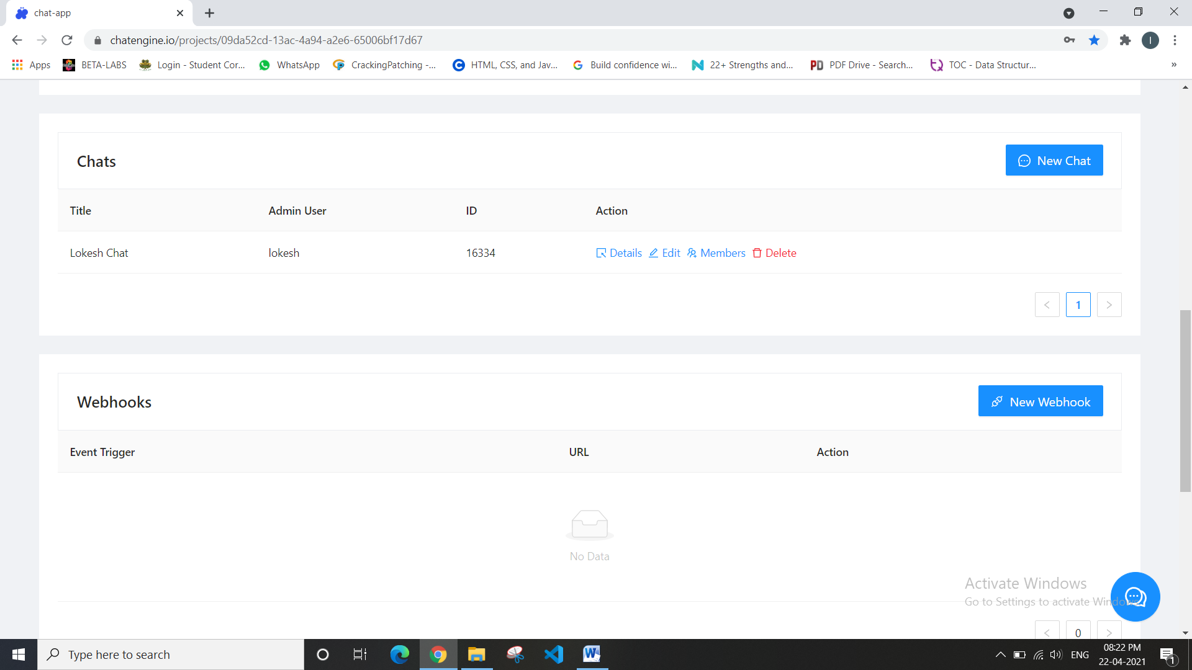

Slide 23


